Slide 1

Northwind
Tehila butbul
July 2024

Slide 2
introduction
Northwind purchases products from various suppliers and sells the world apparently through shipping services all over the world.
The company's gross profit was estimated at 1,354,459$.
The company sells 77 products divided into 8 different categories from 29 different suppliers to 89 customers.
The company includes data on 830 orders made from July 1996 to May 1998.

Slide 3
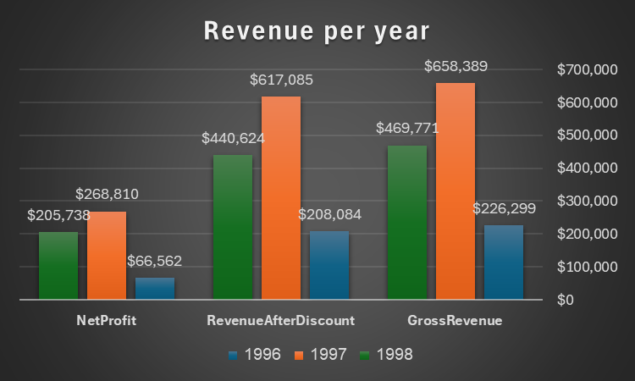
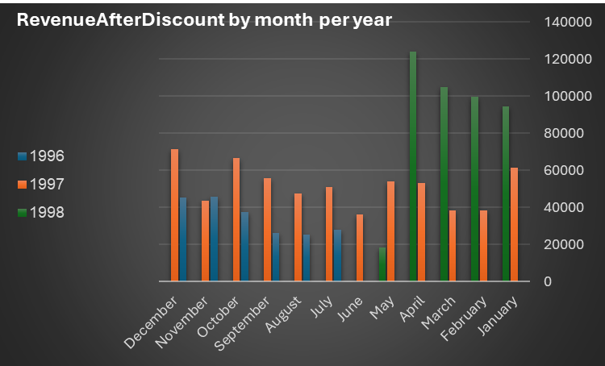
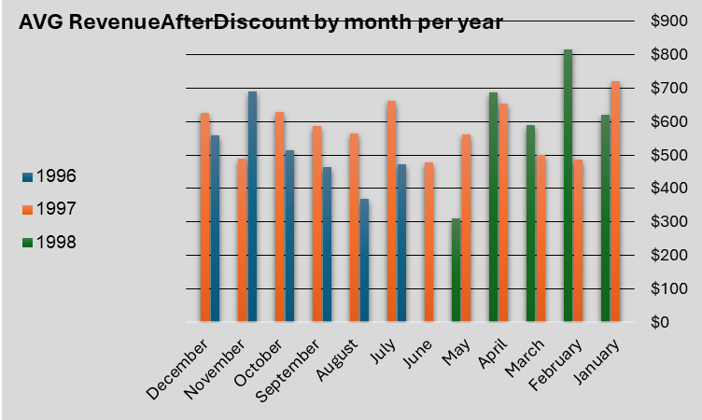
Profit by time
The types of profits shown - gross profit, profit after discounts and profit after discounts and product cost.
1997 was the most profitable year and April 1998 was the most profitable of all.
In the month of November 1996, the average profit was more than the total profit in the same period.
The total profit in 1998 was a higher profit than the same profit in 1997, but the average profit does not seem so difference between these years.

Slide 4
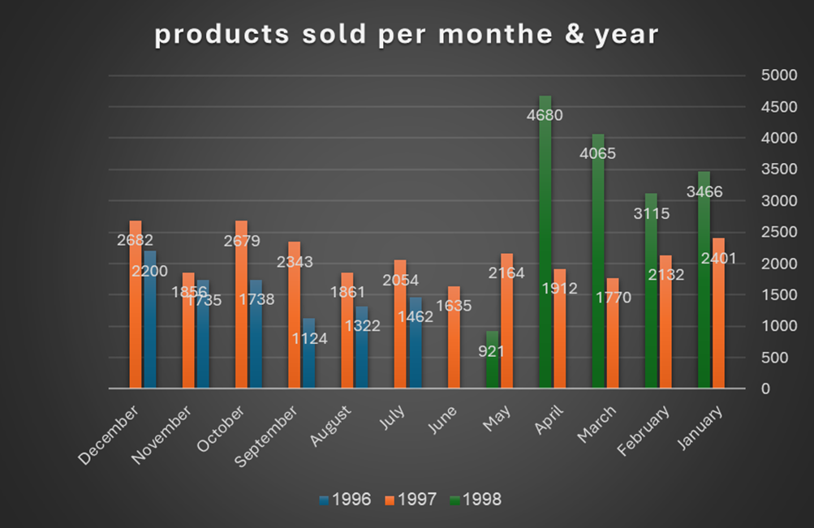
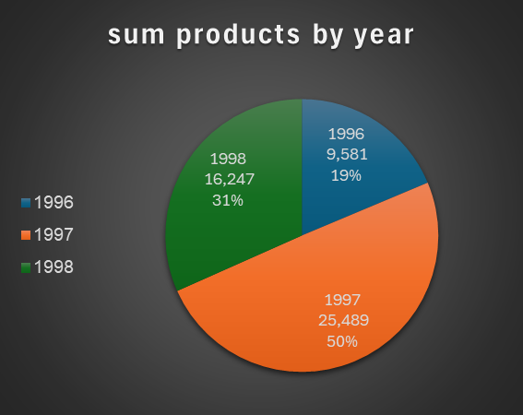
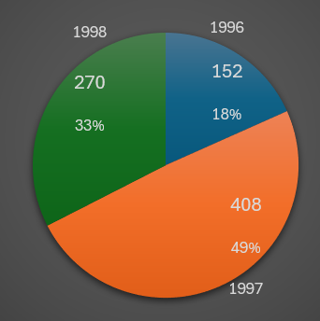
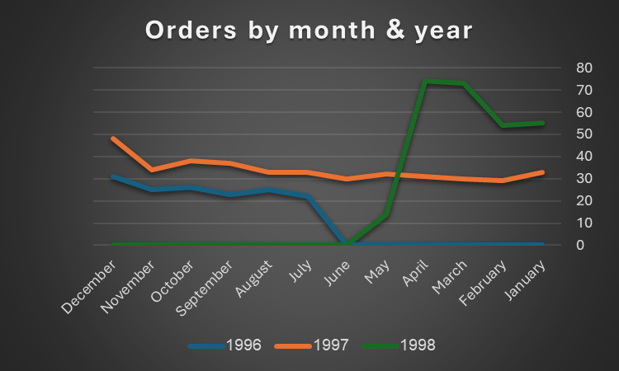
products & orders
In 1998 there was an increase in sales compared to 1997 at the same time.
In April 1998, the most orders were made, and the highest level of products were sold.
The number of orders placed, and the products sold in 1998 and 1996 together, are almost equal in their percentages to 1997.
Orders percentage

Slide 5
Profit recommendations
To examine the marketing activities carried out in the profitable years such as 1997 and 1998 and try to implement them in additional periods of time.
To plan special marketing campaigns in profitable months such as April 1998 and November 1996. special discounts on popular products or the launch of new products to maximize profits.
check why the average profit did not change despite the increase in the general profit. It may be necessary to reduce production and procurement costs and examine discount policies that reduce average profit.
Improve order planning and ongoing management of stock to maximize the profit from large orders and high sales.

Slide 6
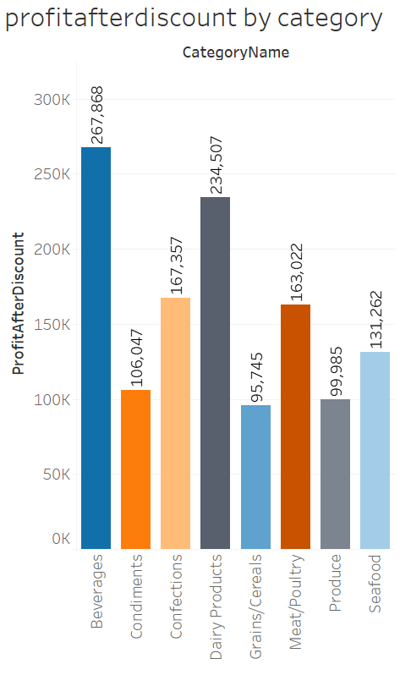
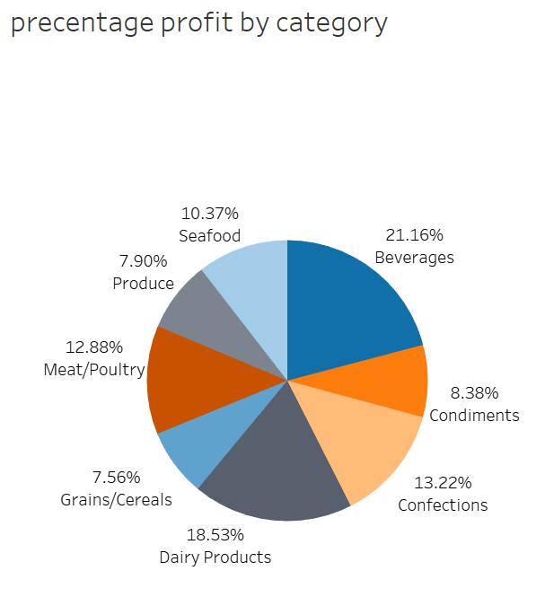
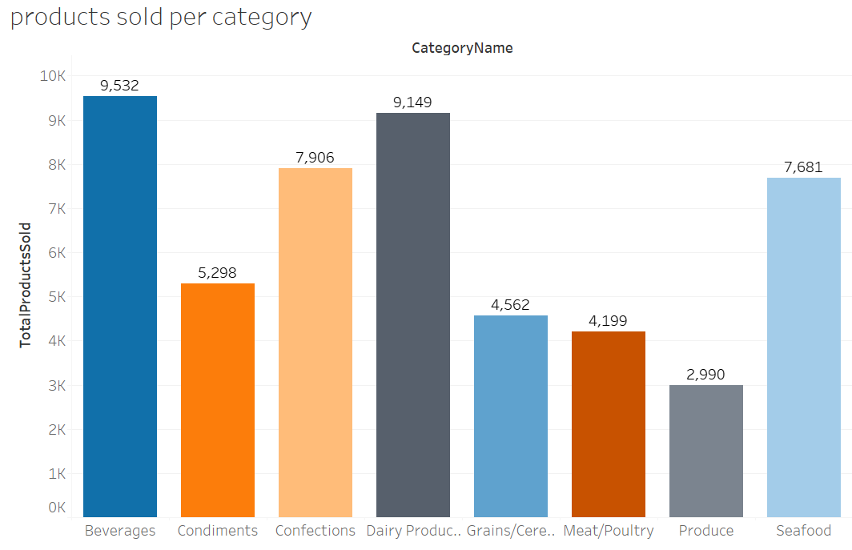
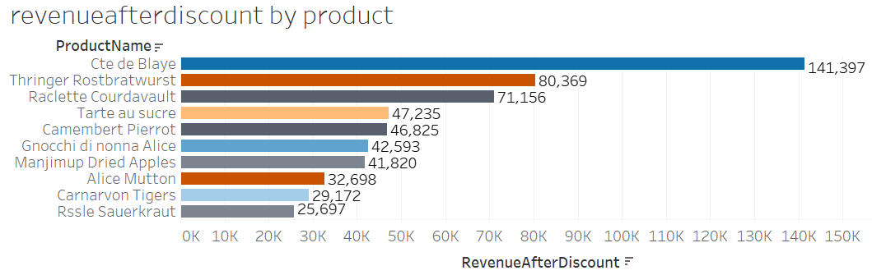
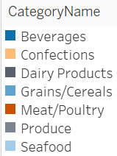
categories
The highest profit after discount is in Beverage's category which makes 21.16% of the profits, but the dairy products category also generates nice profits with a sales percentage of 18.53%.
The least profitable category is Grains/Cereals.
The company's most profitable product is Cte de Blaye from the Beverages category.
The only category that was not included in the list of the 10 most profitable products is condiments category, which out of 8 categories is ranked 6th in terms of profits.
The categories Dairy Products, Produce, Meat/Poultry have 2 products each listed.

Slide 7
Category recommendations
Increase promotions and marketing activities on products from profitable categories. For example, to do promotions of product packages and special discounts on products in these categories.
Examine the possibility of adding new products or changing existing products in profitable categories.
Analyze the products that are on the list of the most profitable products and identify characteristics that lead to their success.
In order to improve profitability in the Grains/Cereals category, it is possible to examine reducing the discounts given to products or, alternatively, to reduce production and marketing costs.

Slide 8
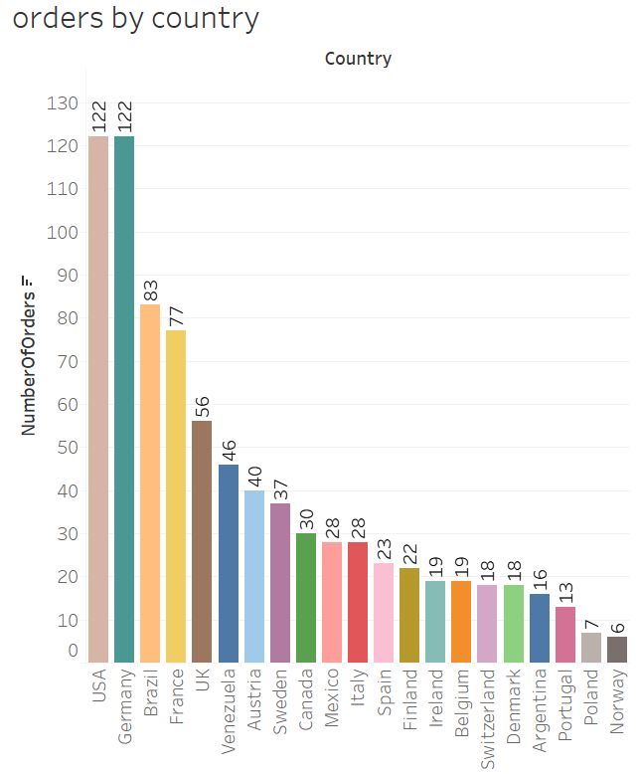
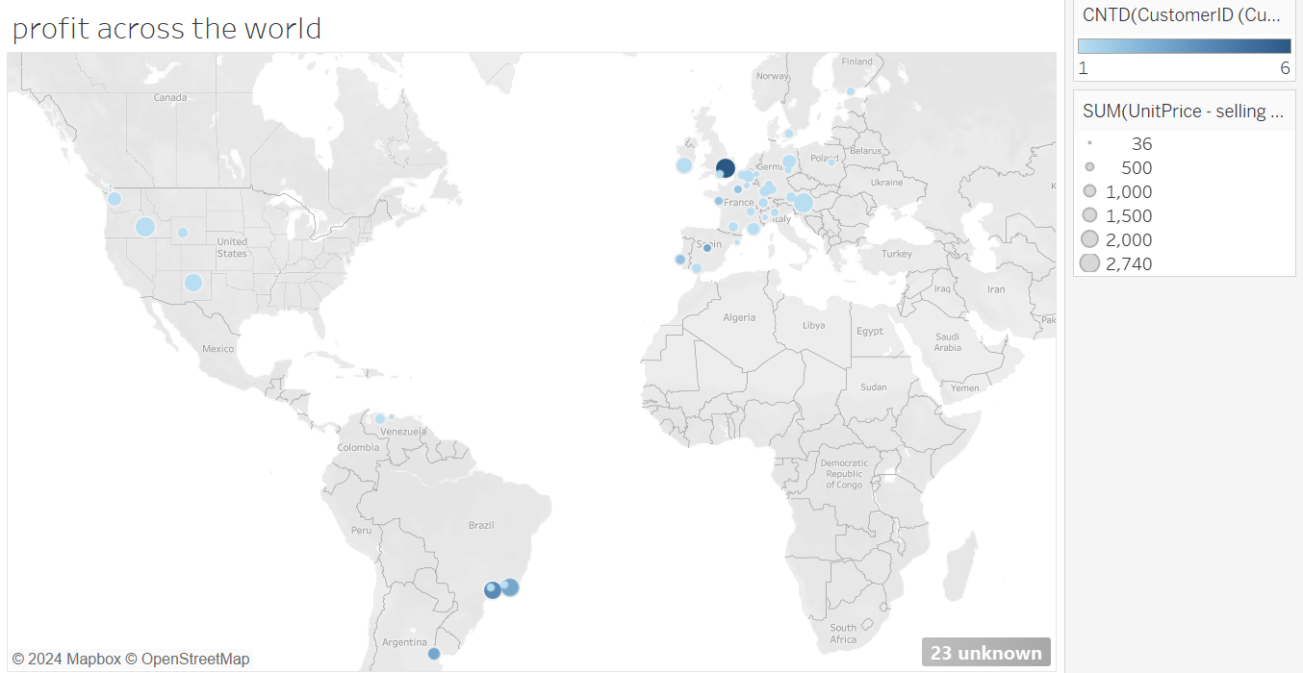
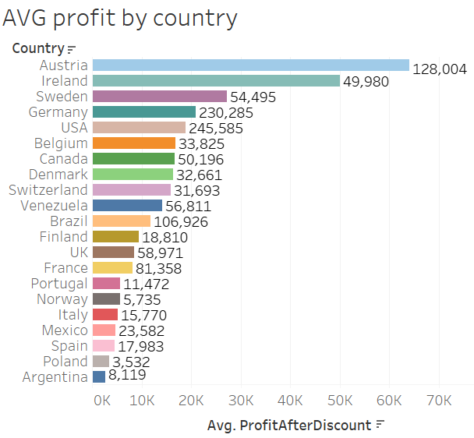
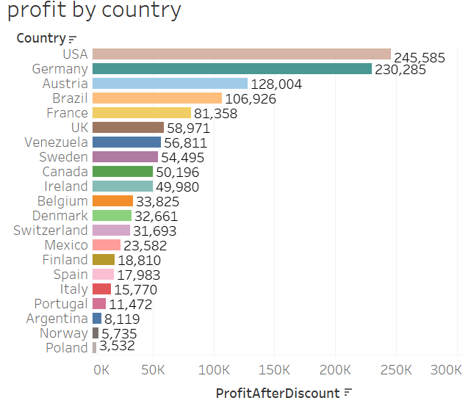
countries
The most profitable countries with the largest number of orders are the USA and Germany
The countries with the highest average profit are Ireland and Austria.
The lowest profit is in Poland and the lowest average profit is in Argentina.
The lowest number of orders is in Norway.

Slide 9
Country recommendations
Investment in profitable countries by marketing campaigns focused on profitable products, collaborations with retailers and local influencers and organizing exhibitions in central cities.
Increasing sales in Austria and Ireland where the average profit is particularly high: you can offer unique benefits to encourage purchases and online and local advertising for products.
Improving operations in Poland and Argentina: the factors leading to low profitability must be analyzed, prices adjusted to the local market and customer service and logistics improved.
Explore country behavior: Track sales by country days and holidays and plan marketing promotions based on local events like US Independence Day or Christmas.

Slide 10
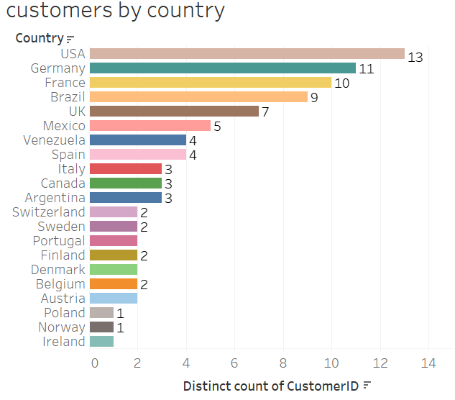
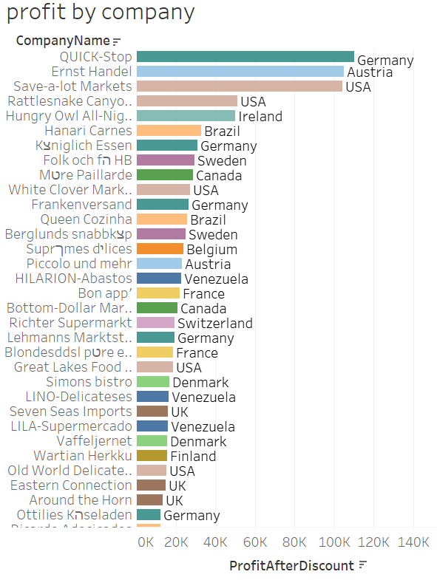
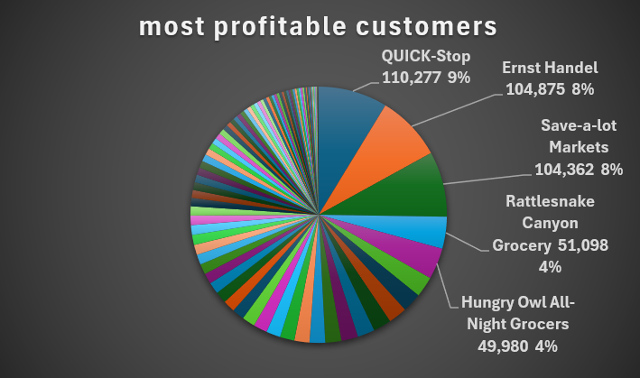
customers
There are 91 customers but only 89 have placed an order. The customers FISSA, PARIS do not appear in the order list.
Brazil, France, Germany, UK, USA are the countries with the highest number of customers.
The 2 most profitable customers belong to the USA
The profit percentages of the 5 most profitable customers make up about 1/3 of the company's overall sales percentage.

Slide 11
customer recommendations
To maintain contact with leading customers such as USA, it is necessary to analyze profitable behavior and offer personalized offers.
Send a survey to FISSA and PARIS customers who have not placed orders to understand their needs and problems.
Offer unique promotions to customers who haven't made orders in a long time, such as discounts on the first order after a long period or products as gifts.
Conduct customer retention campaigns, such as unique promotions for repeat buyers, special benefits such as free shipping, advance orders or early access to promotions. In addition, develop a loyalty program for regular customers.

Slide 12
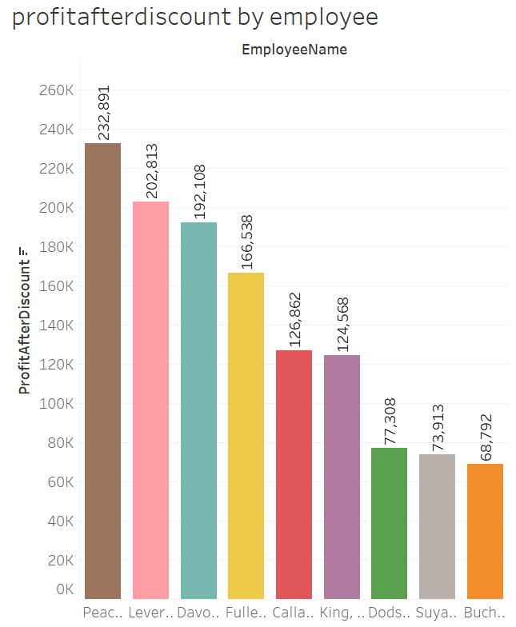
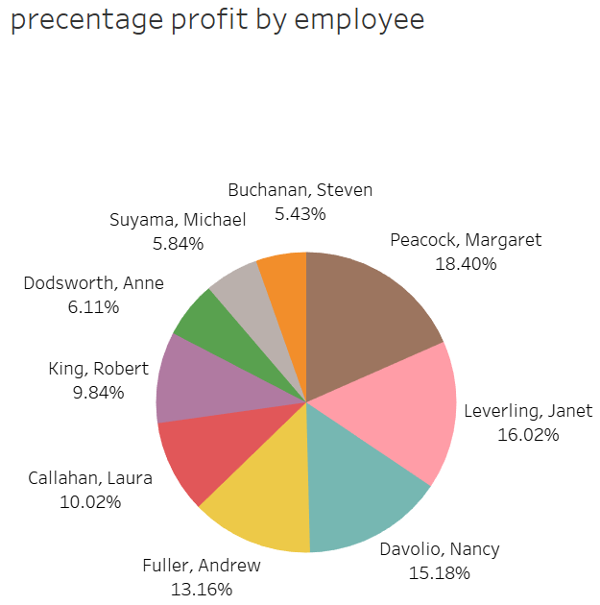
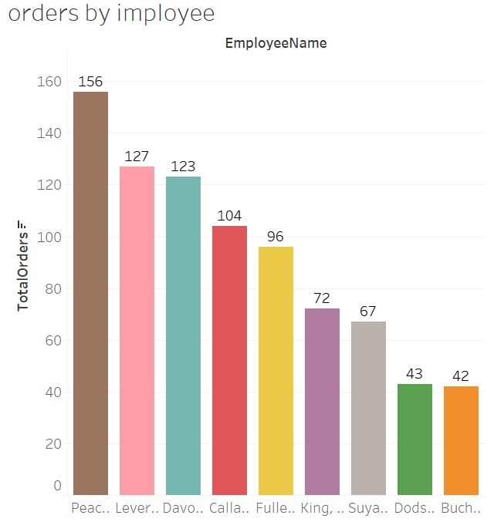
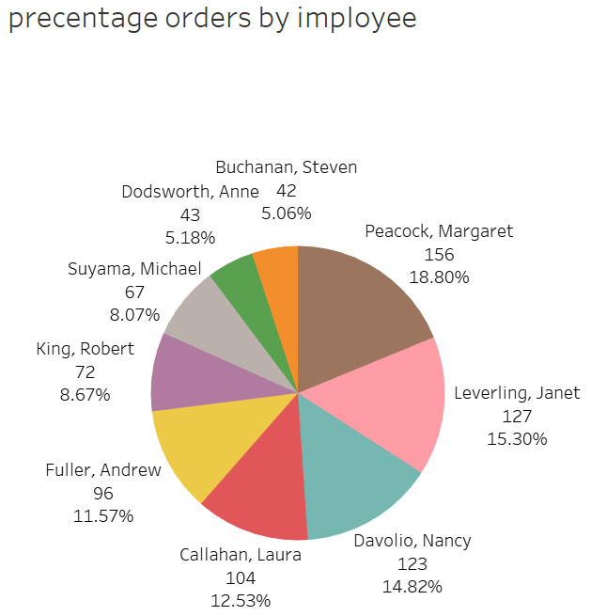
employees
Margaret is the most profitable employee for the company, but Janet is also extremely profitable
Steven showed the lowest sales performance
Not necessarily the one who makes many orders necessarily provides the largest number of profits. For example, Laura made more orders than Andrew, but the latter provided higher profits.

Slide 13
Employee recommendations
Checking the performance of the employees who make a lot of orders but with low profitability like Laura and try to improve the quality of the orders. A feedback meeting can be organized in order to identify problems and improve the quality of orders.
Provide training and guidance to lower performing employees like Steven to improve their performance.
To Examining the work strategies of successful employees like Margaret and Janet, it can be Organize meetings of professional employees sharing their work practices with other teams.

Slide 14
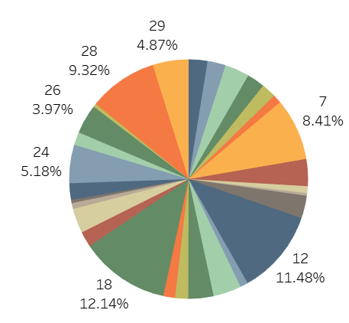
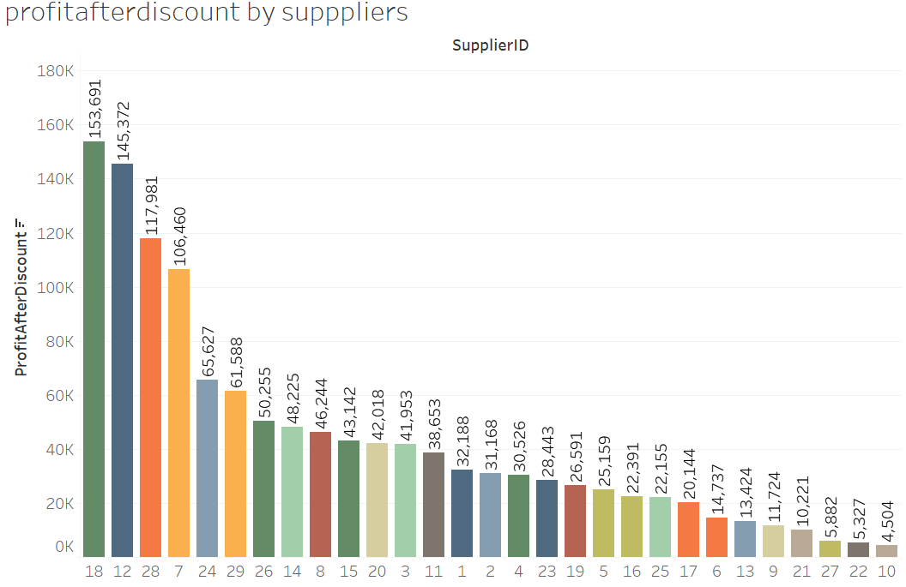
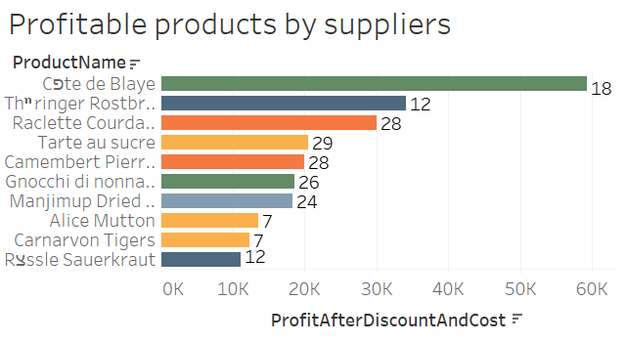
Suppliers
Percentage profit by suppliers
Supplier 18 has the highest profit percentage.
The least profitable providers are 10, 22, 27.
Suppliers number 28, 12, 7 repeat themselves in the list of the most profitable products

Slide 15
Supplier recommendations
Analyze the working practices of profitable suppliers such as delivery times and other performance indicators and consider expanding cooperation by proposing to increase the volume of orders.
Offer profitable suppliers the signing of long-term agreements and the development of plans for strategic collaborations such as new products or special promotions.
Collecting data on the performance of the least profitable suppliers and analyzing the reasons for the low profitability.
If necessary, consider replacing these suppliers by identifying other potential suppliers in the market.

Slide 16
questions?

